Slide 1
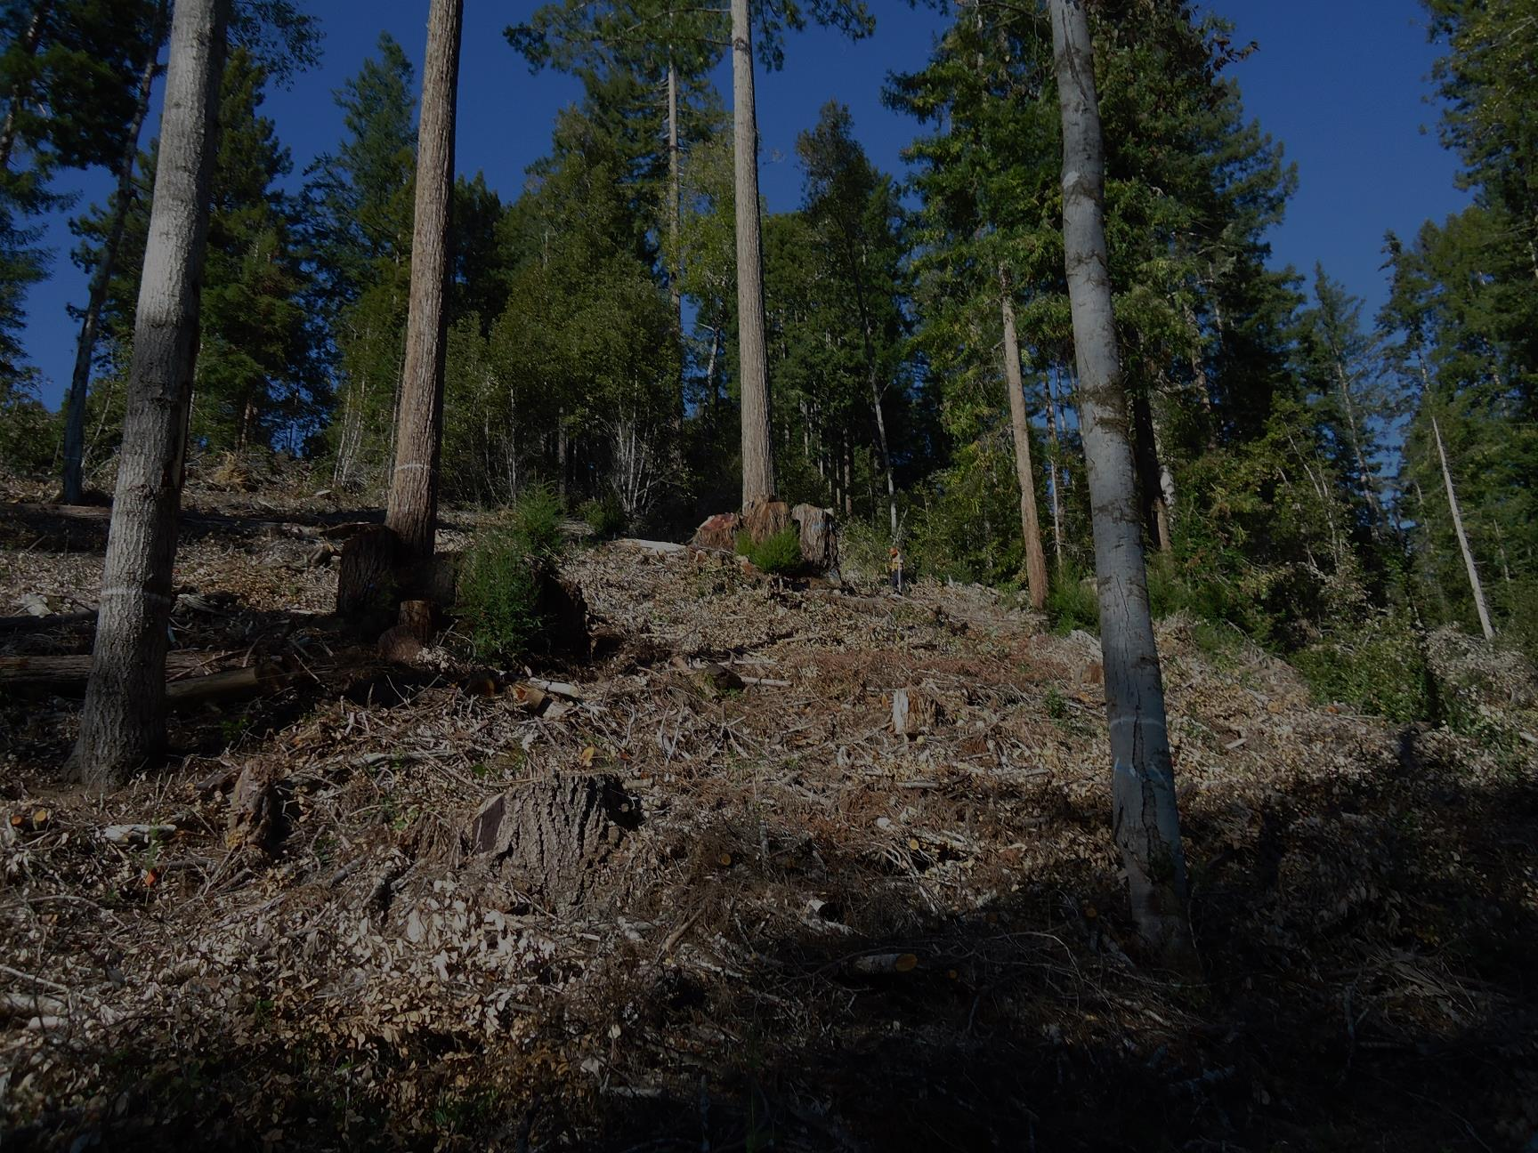
Kriging Understory Light to Predict
Stump Sprout Growth in Mixed Multiaged Stands
in North Coastal California
John-Pascal Berrill, Kurt A. Schneider, Christa M. Dagley
Forestry and Wildland Resources, Humboldt State University
and
Lynn A. Webb
Jackson Demonstration State Forest, California Department of Forestry and Fire Protection (CAL FIRE)

Slide 2
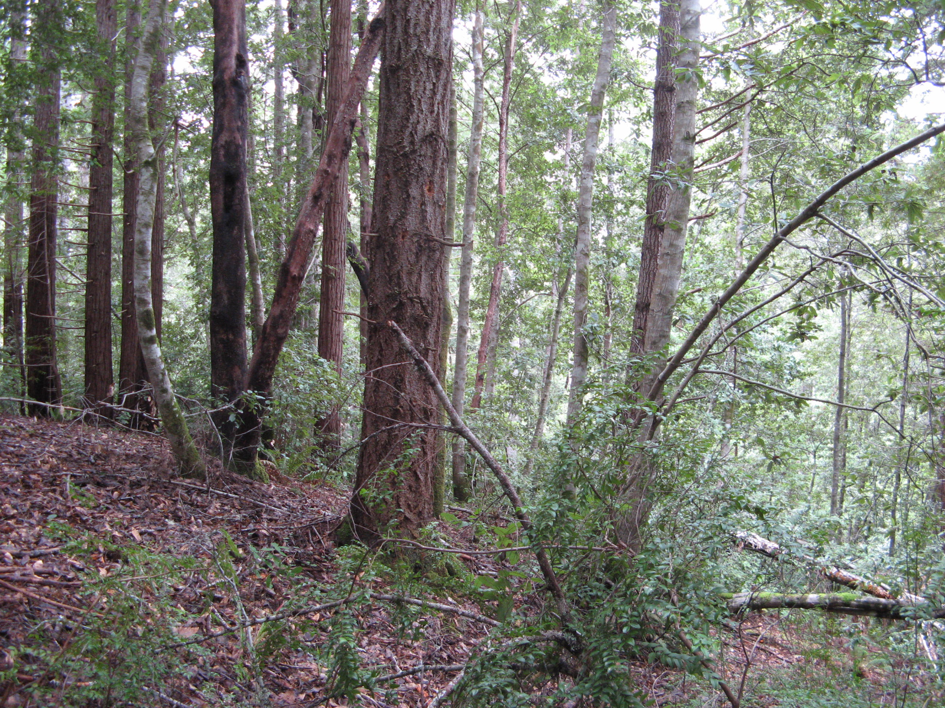
Redwood/Douglas-fir/tanoak stands regenerated naturally after old-growth was removed

Slide 3
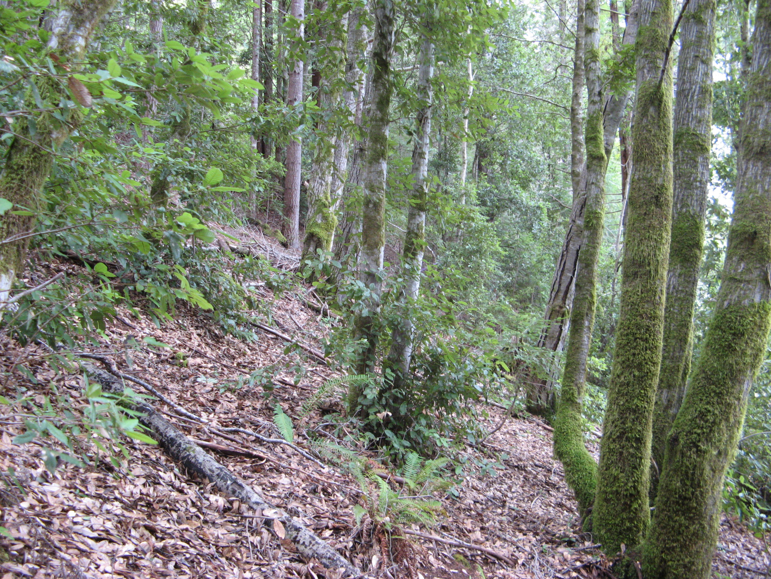
Patchy distribution of species

Slide 4
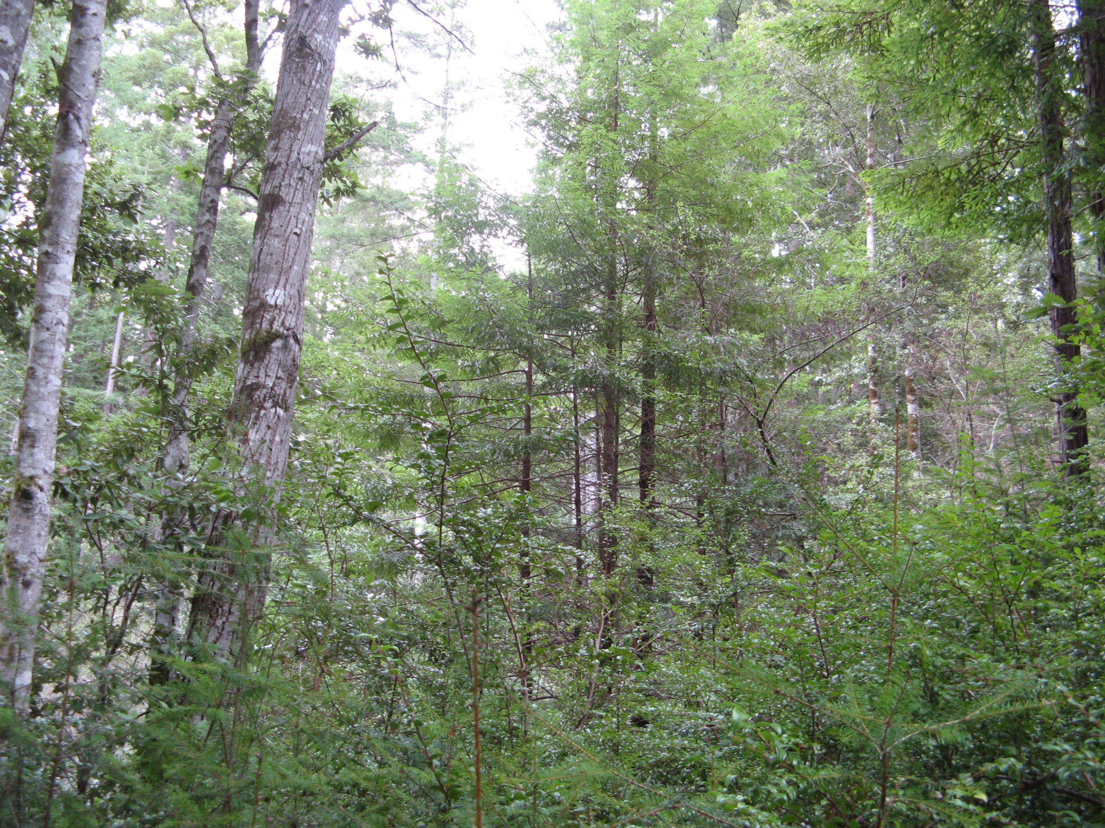
Natural regeneration after partial harvesting: redwood and tanoak sprouts, and conifer seedlings (Douglas-fir, grand fir, w. hemlock)

Slide 5
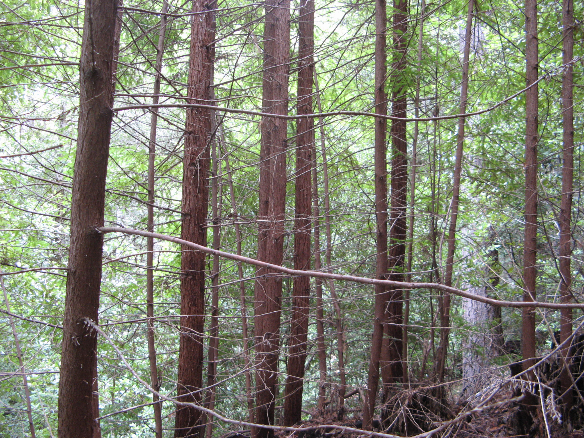
Redwood stump sprouts from most recent partial harvest

Slide 6
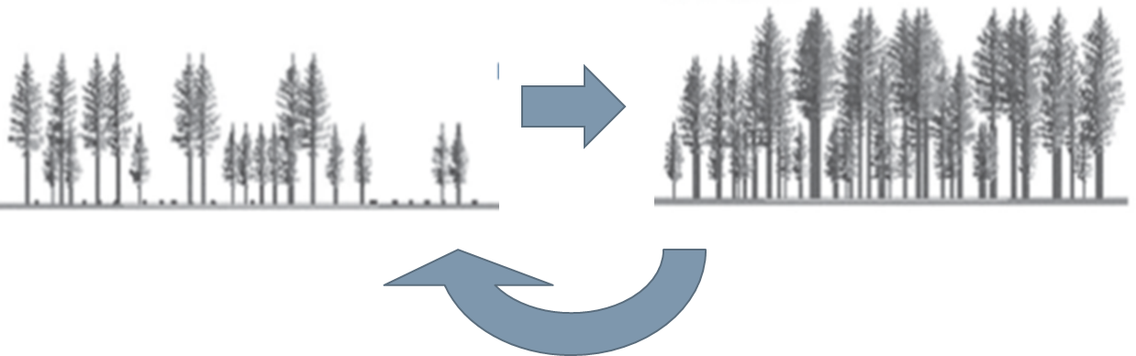
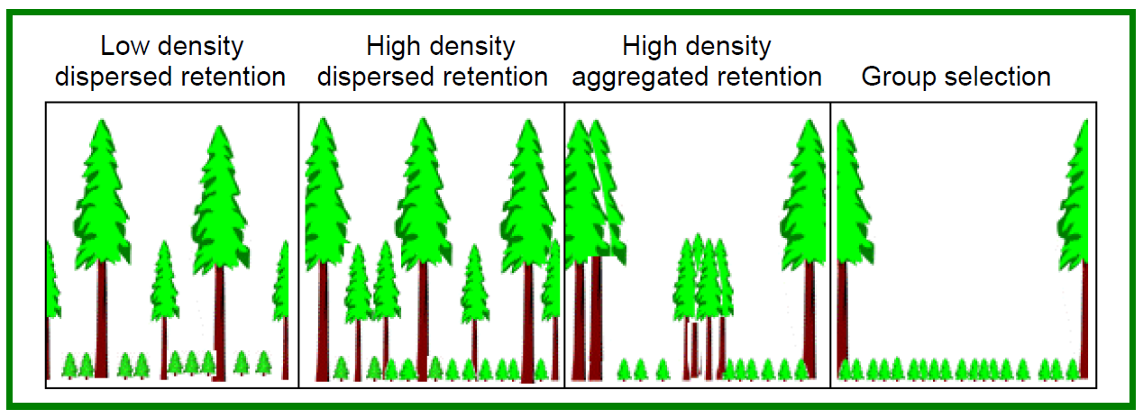
Study Conversion to Uneven-aged Management
Conversion
Grow
Harvest
Notes:
The purpose of multiaged variable retention management is to create and sustain a stand structure with multiple ages or cohorts. Partial Harvesting is used to create the multiaged stand on the left. Over time the stand develops and regeneration fills in the growing space until it becomes fully stocked, at which a partial harvest is performed again recreating the structure on the left and the cycle continues. Various Partial Harvest treatments can be performed leaving different spatial patterns at varying densities such as High Density Aggregated retention low density dispersed retention and group selection treatments

Slide 7
Study Conversion to Uneven-aged Management
Research question:
How do stand density and spatial pattern of retention affect understory light environment and regeneration of stump sprouts and planted seedlings?
Specifically:
How does understory light vary between and within treatments?
How does light affect growth of stump sprouts and seedlings?
Which treatment favors redwood sprouts over tanoak sprouts?
Notes:
We wanted to answer the following questions:
1) Is there a significant relationship between the spatial orientation and density of the residual overstory and height growth increment of seedlings?
2) If significant, can a retention harvest treatment be identified which optimizes height growth?
3) Is there a significant relationship between the spatial orientation of the overstory, size/vigor of seedlings, and deer herbivory of seedlings?
4) If significant, can a treatment be identified which minimizes deer herbivory?
5) Which treatment optimizes height growth increment of seedlings, while also minimizing browsing effects?

Slide 8
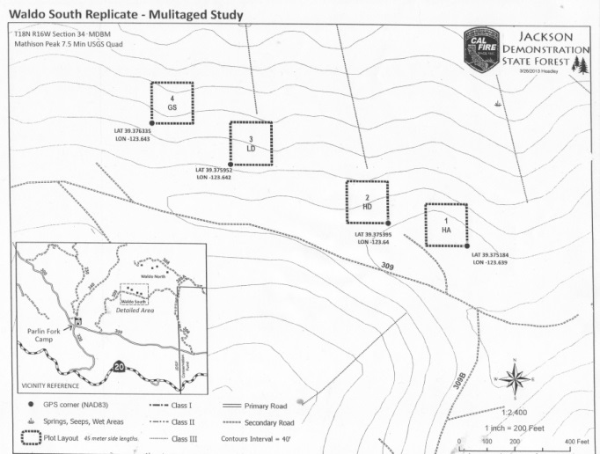
Survey and mark 5-acre (2 ha) treatment blocks
Group
selection
Low density
dispersed
High density
dispersed
High density
aggregated

Slide 9
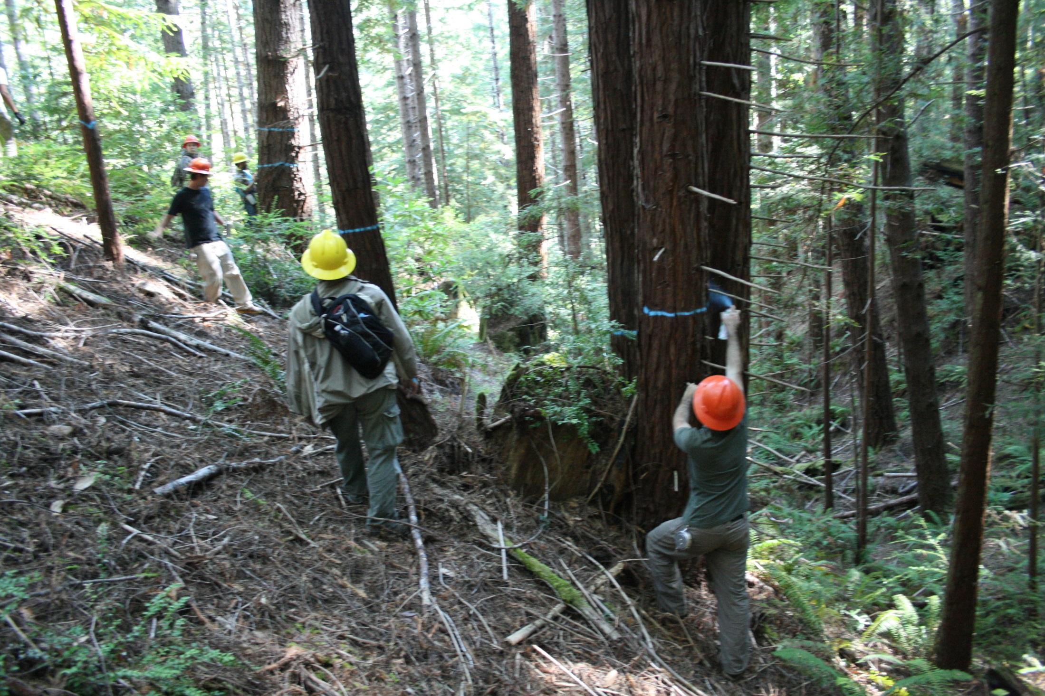

Slide 10
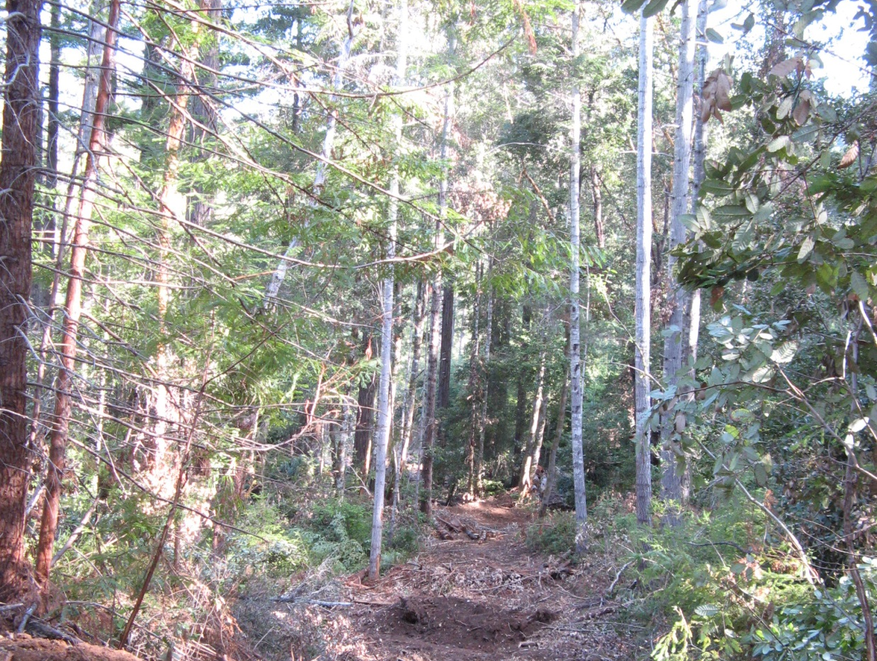
Ground-based harvest on upper slopes and ridges

Slide 11
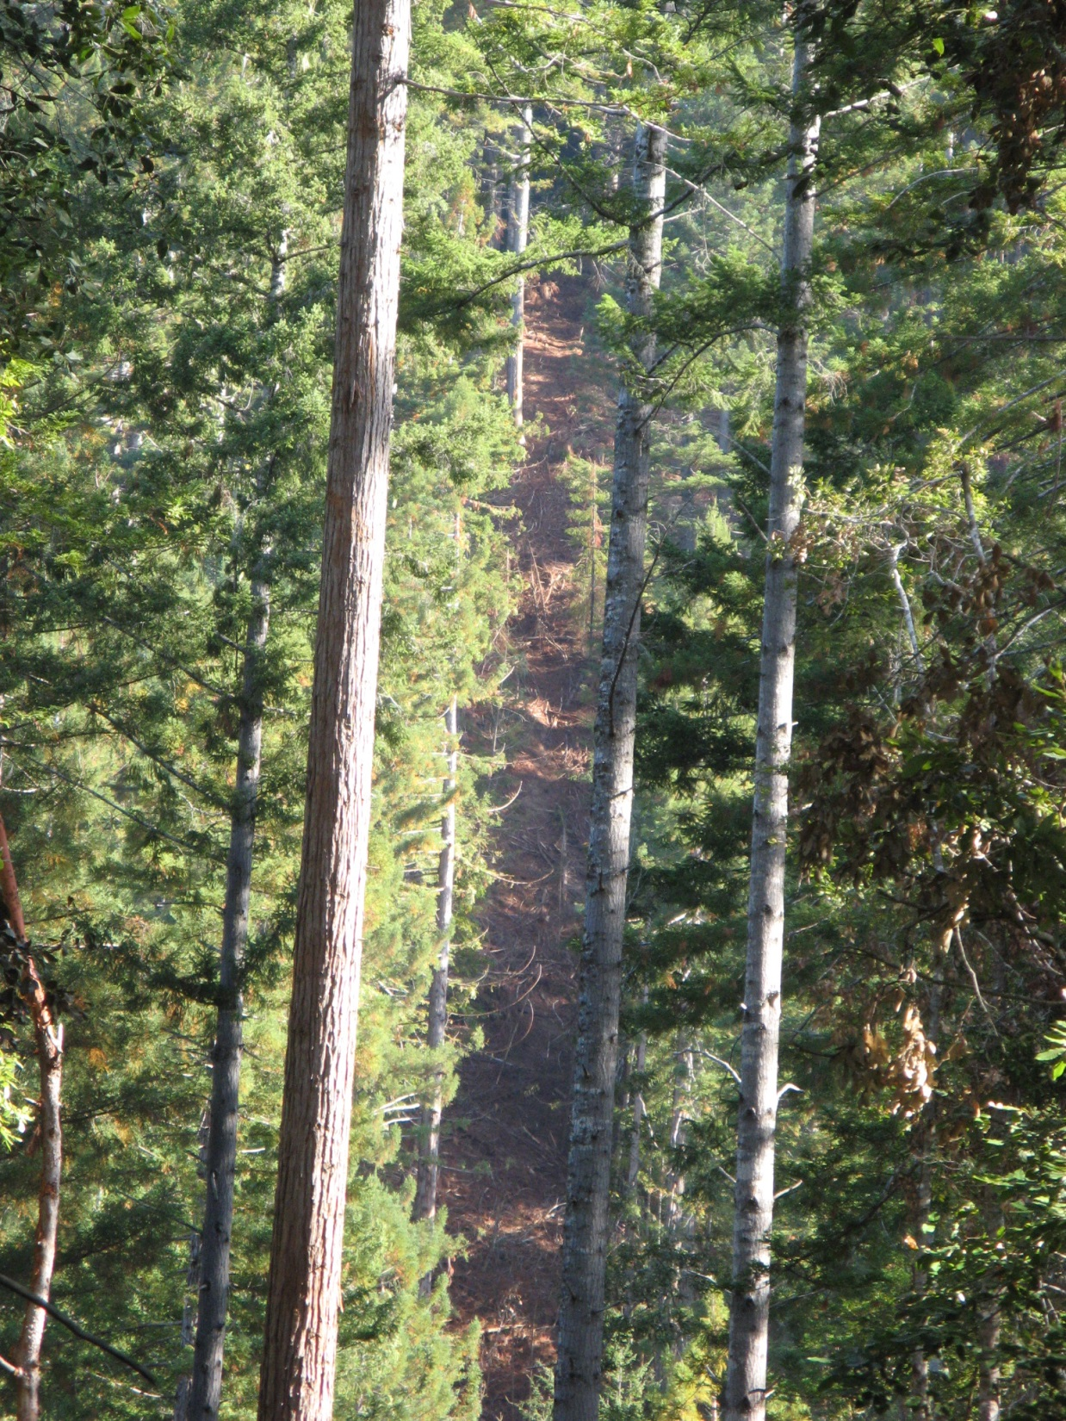
Cable harvest on steeper slopes and across gullies

Slide 12
After harvest, install ½ acre (0.2 ha) permanent plots

Slide 13
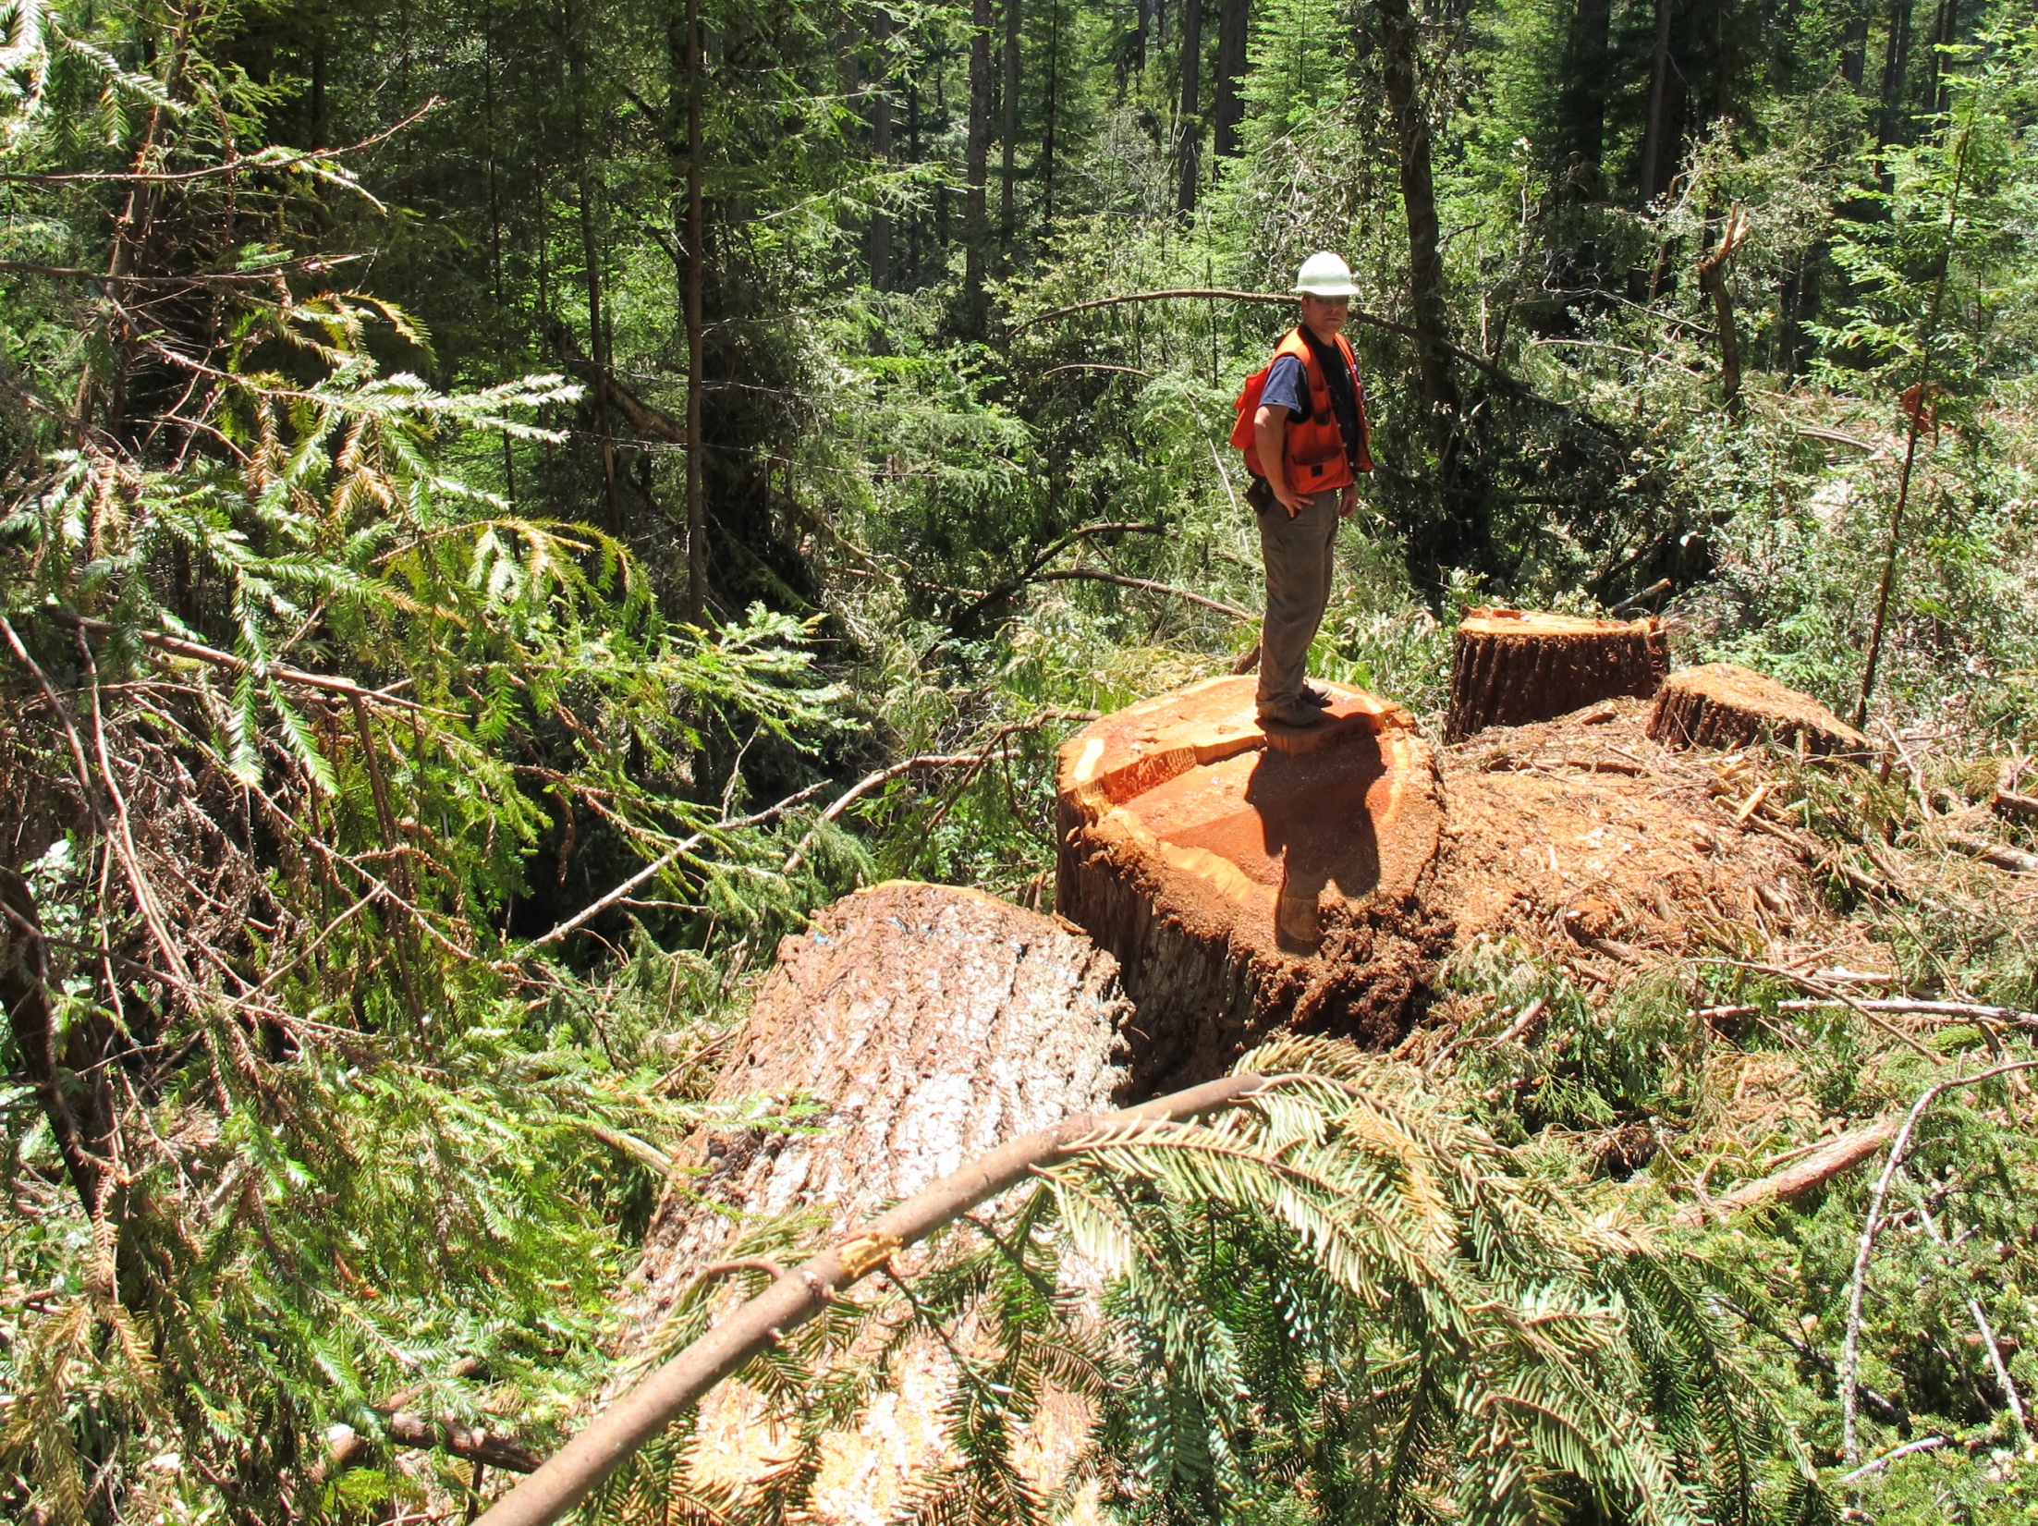
Single-tree selection

Slide 14
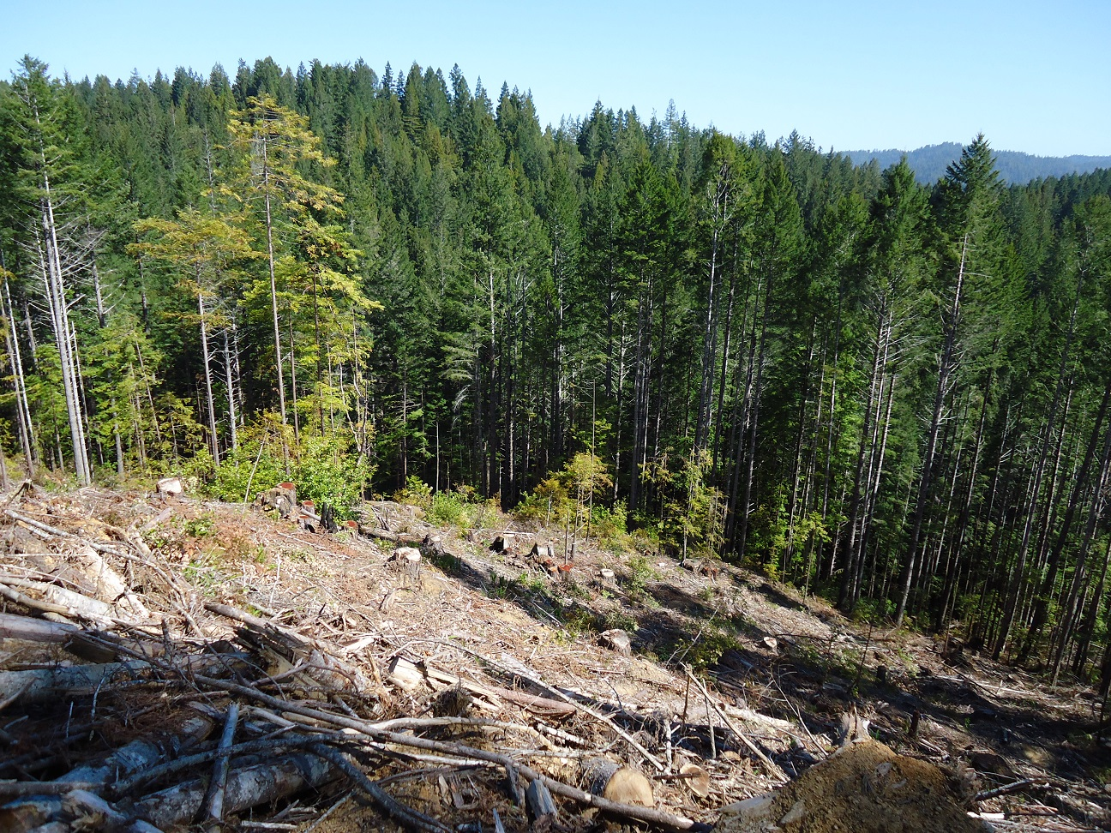
Group selection opening (2.5 acres/1 ha)

Slide 15
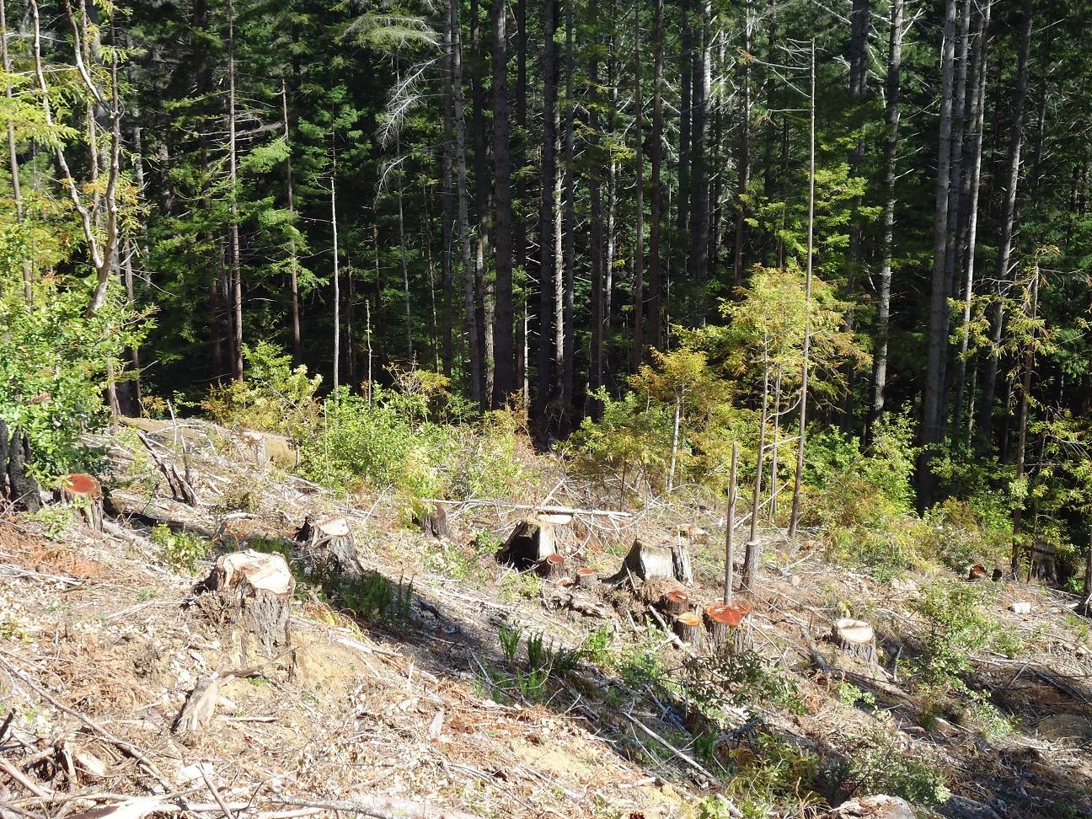
Group selection opening (2.5 acres/1 ha) before lop & scatter

Slide 16
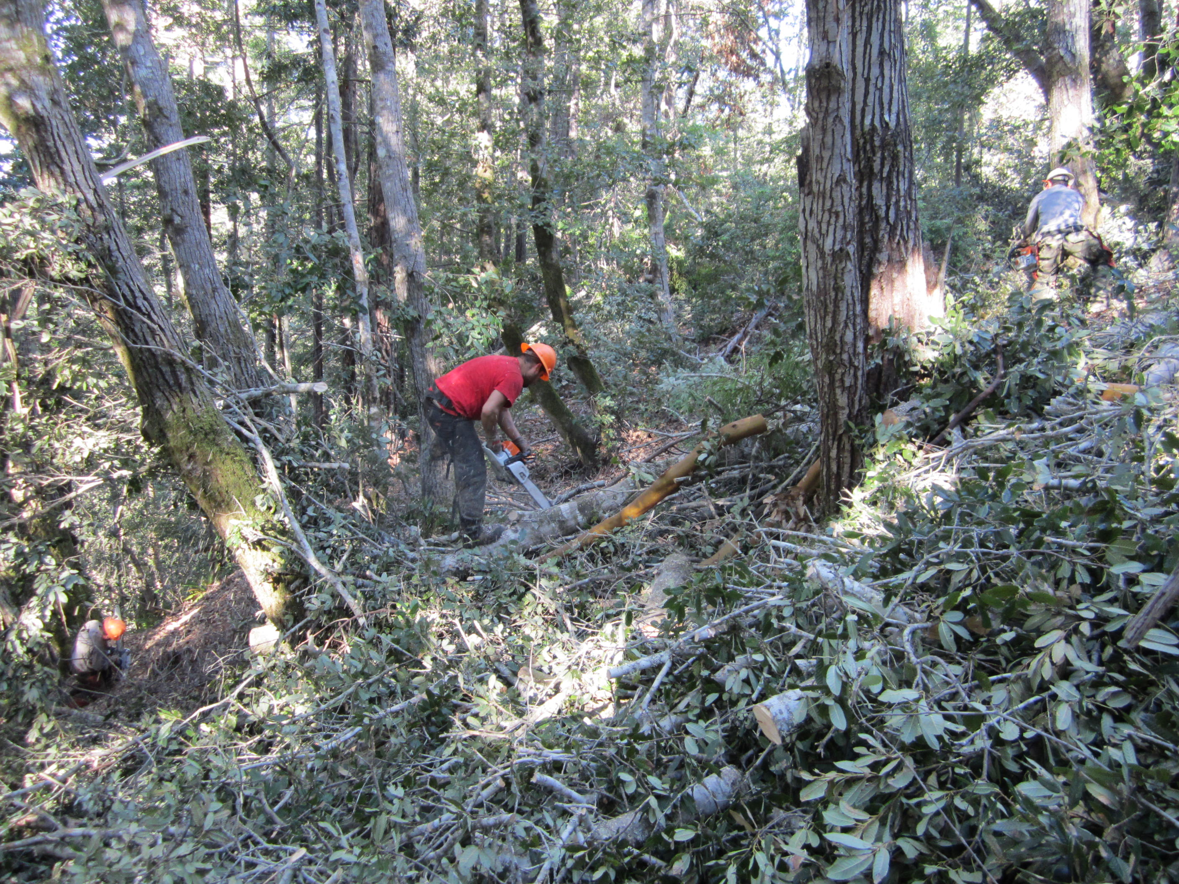
Post-harvest lop & scatter treatment applied to unwanted small conifers and tanoak

Slide 17
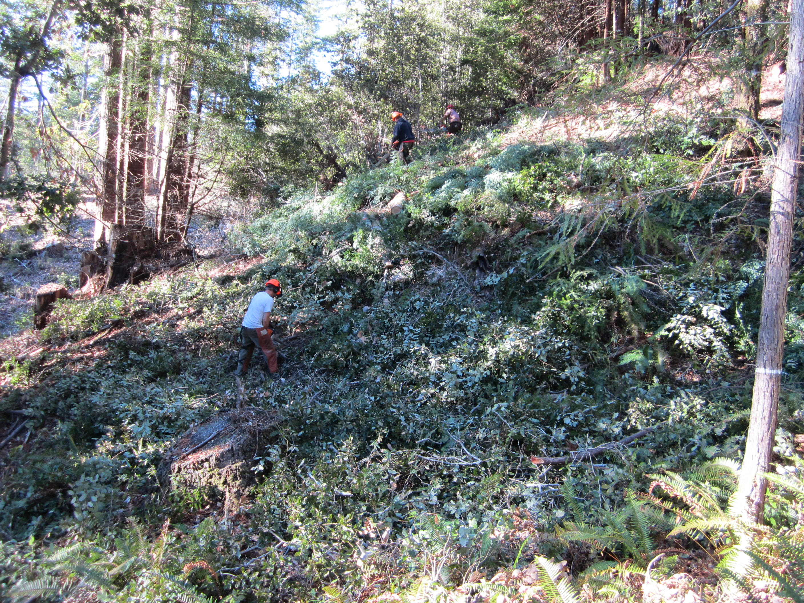
Post-harvest lop & scatter treatment applied to unwanted small conifers and tanoak

Slide 18
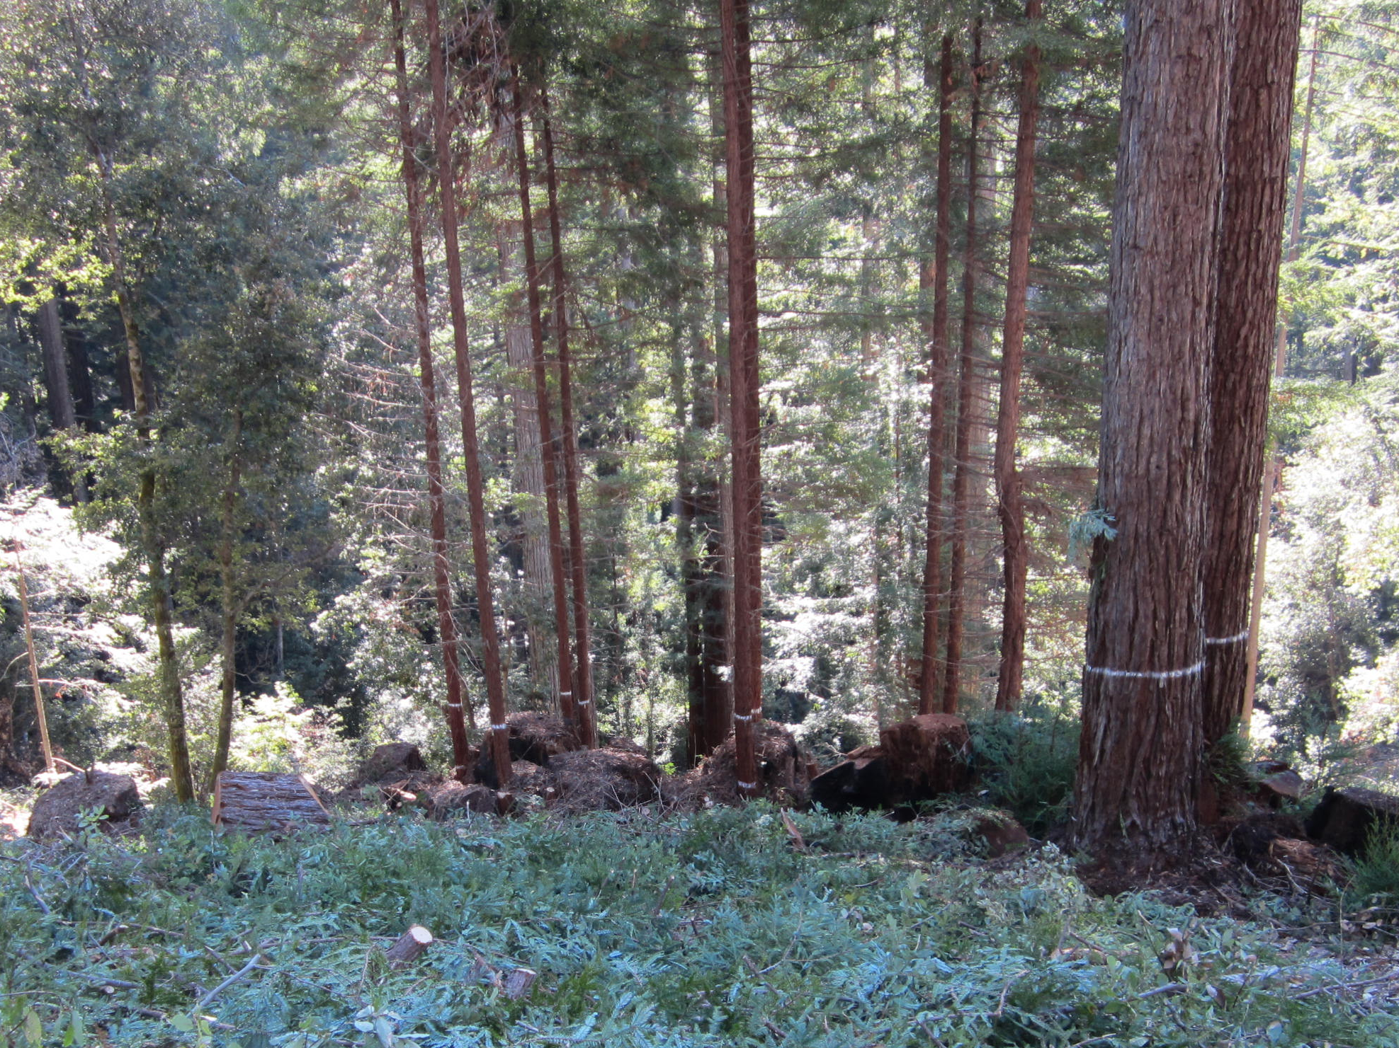
Aggregated treatment
Midstory clump & overstory clump

Slide 19
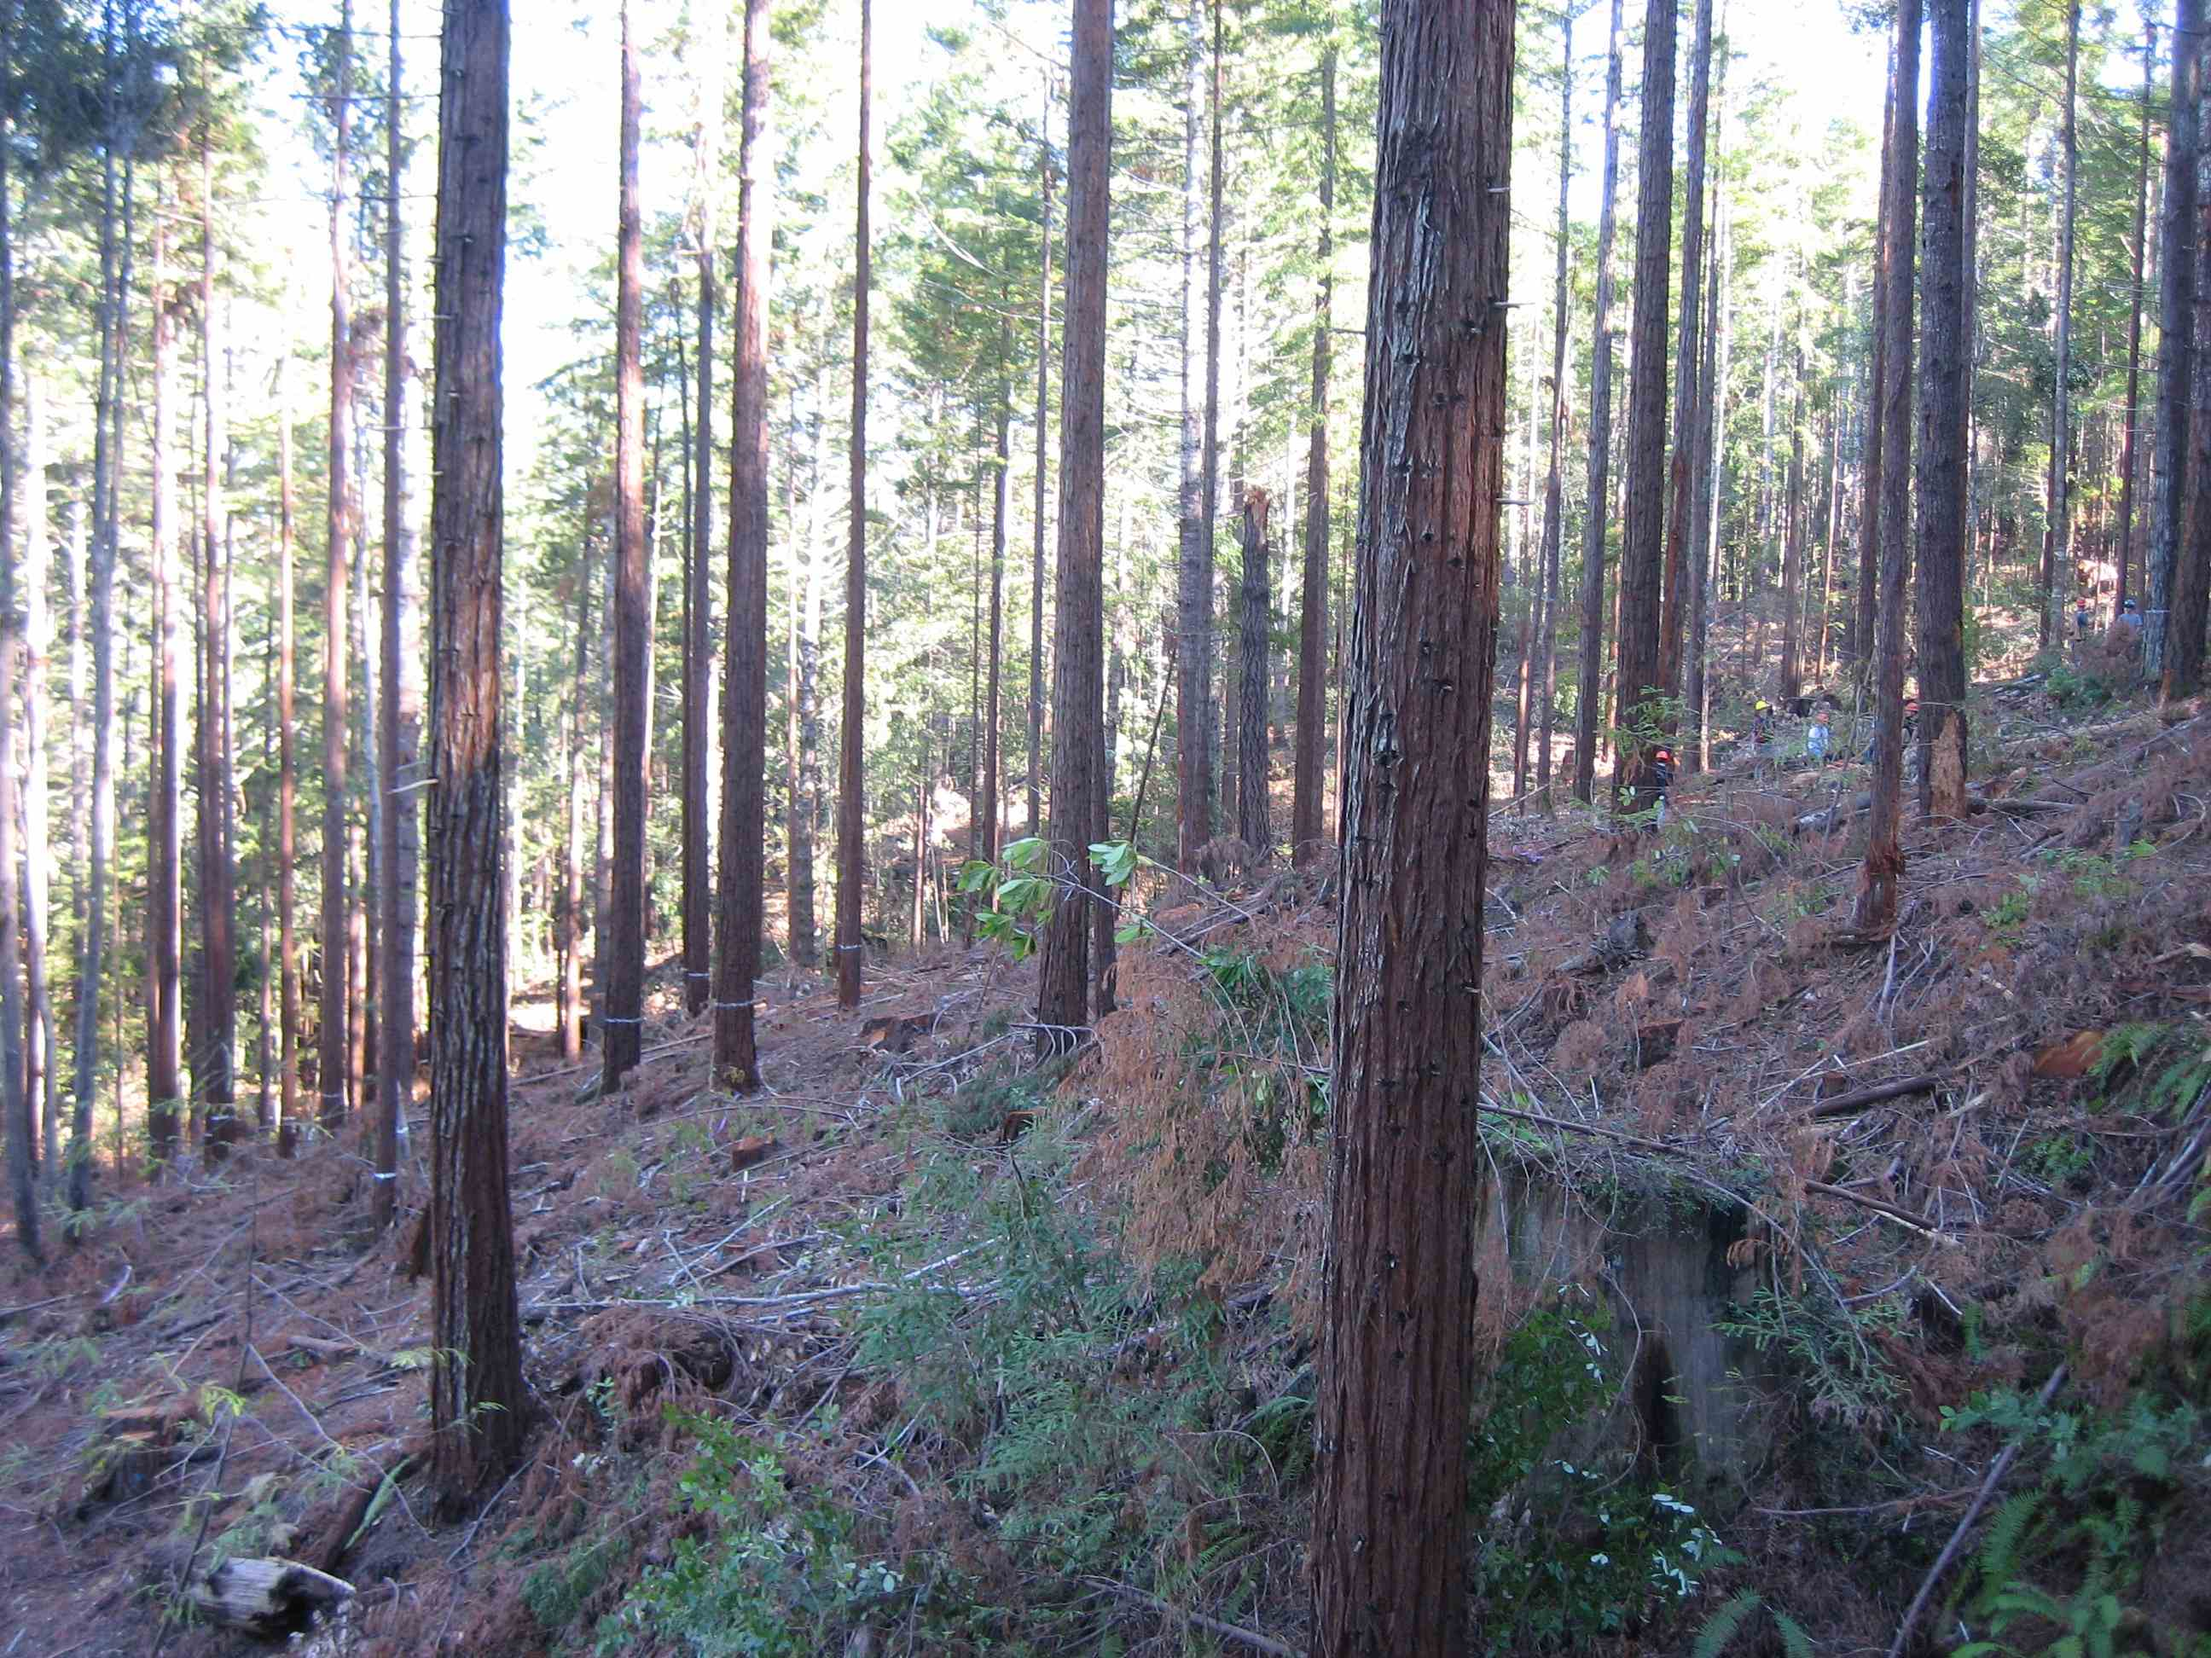
Dispersed treatment (uniform retention)

Slide 20
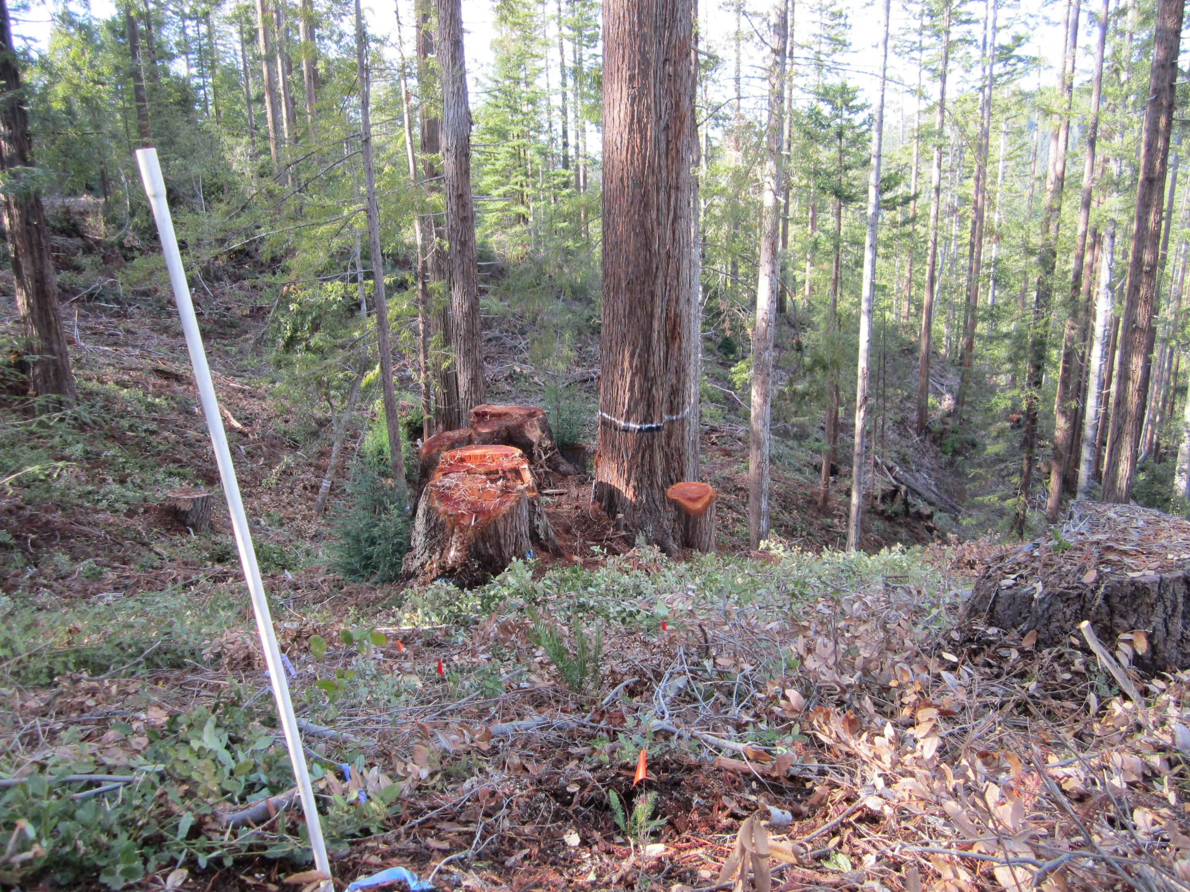
Redwood and Douglas-fir seedlings planted throughout ½ acre (0.2 ha) measurement plot

Slide 21
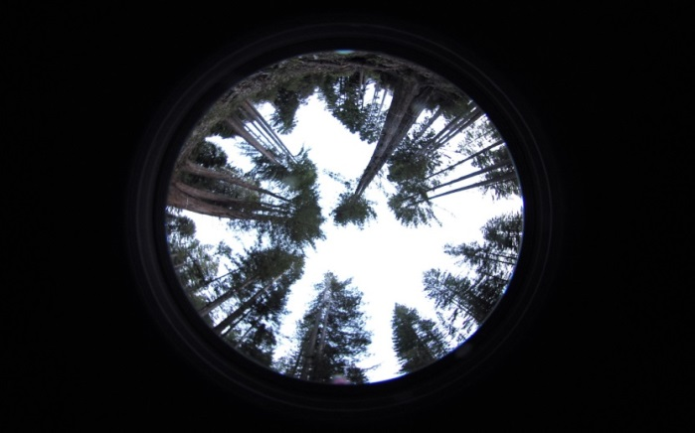
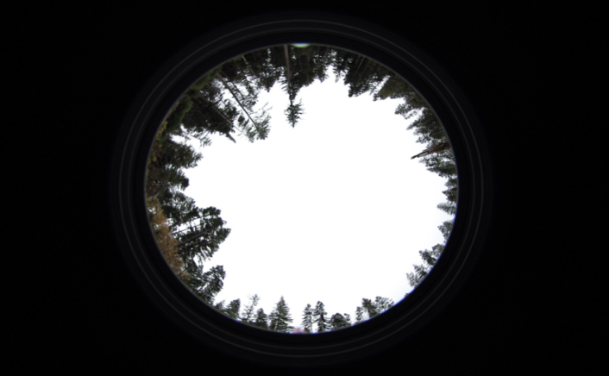
High Density Aggregated
Group Selection
Kriging interpolation of understory light between points where hemispherical photos were taken

Slide 22


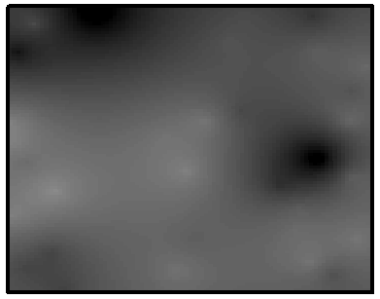

High density dispersed
High density aggregated
Maps of percent above canopy light (PACL)
Low density dispersed
Group selection

Slide 23
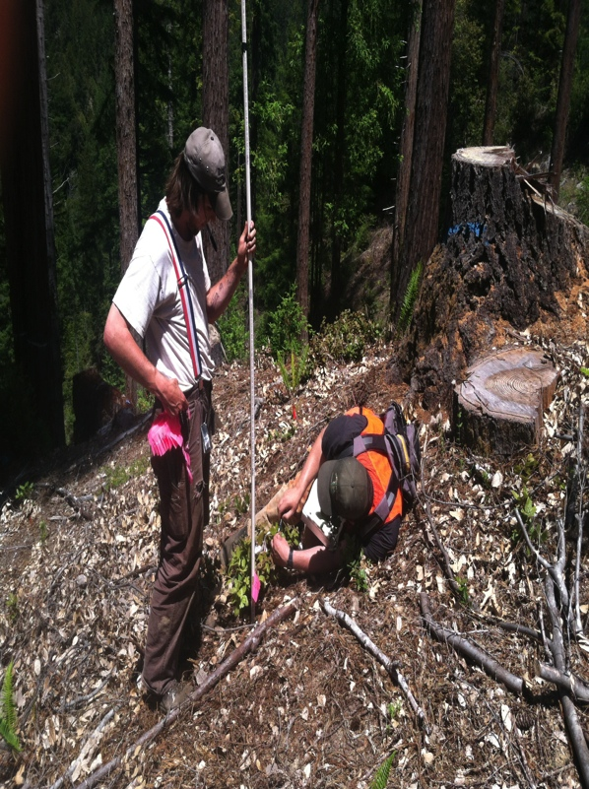
Repeatable height measurements taken from pinflag location

Slide 24
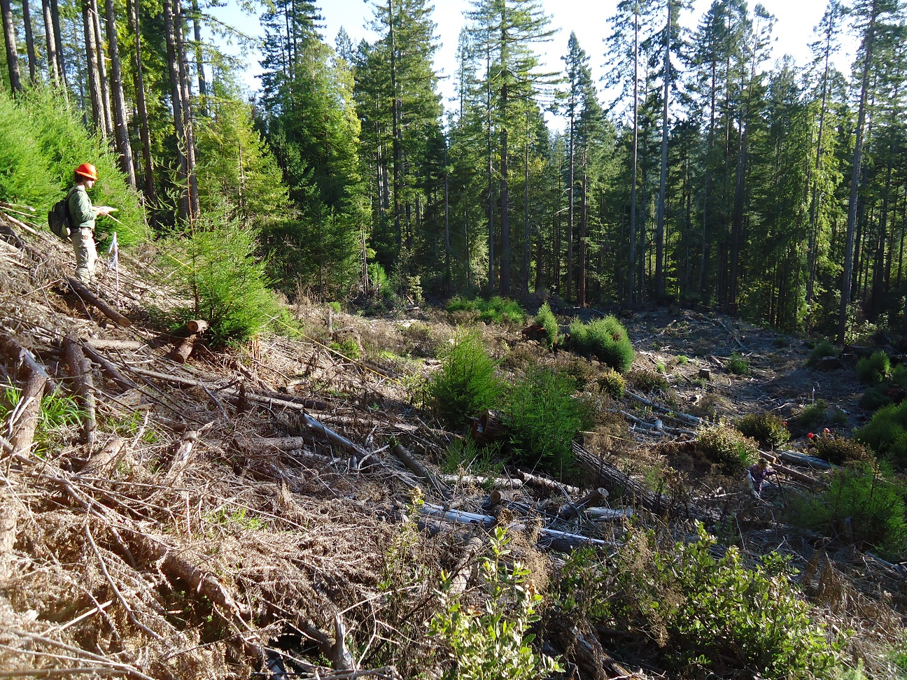
2014 (2 years post-harvest)

Slide 25
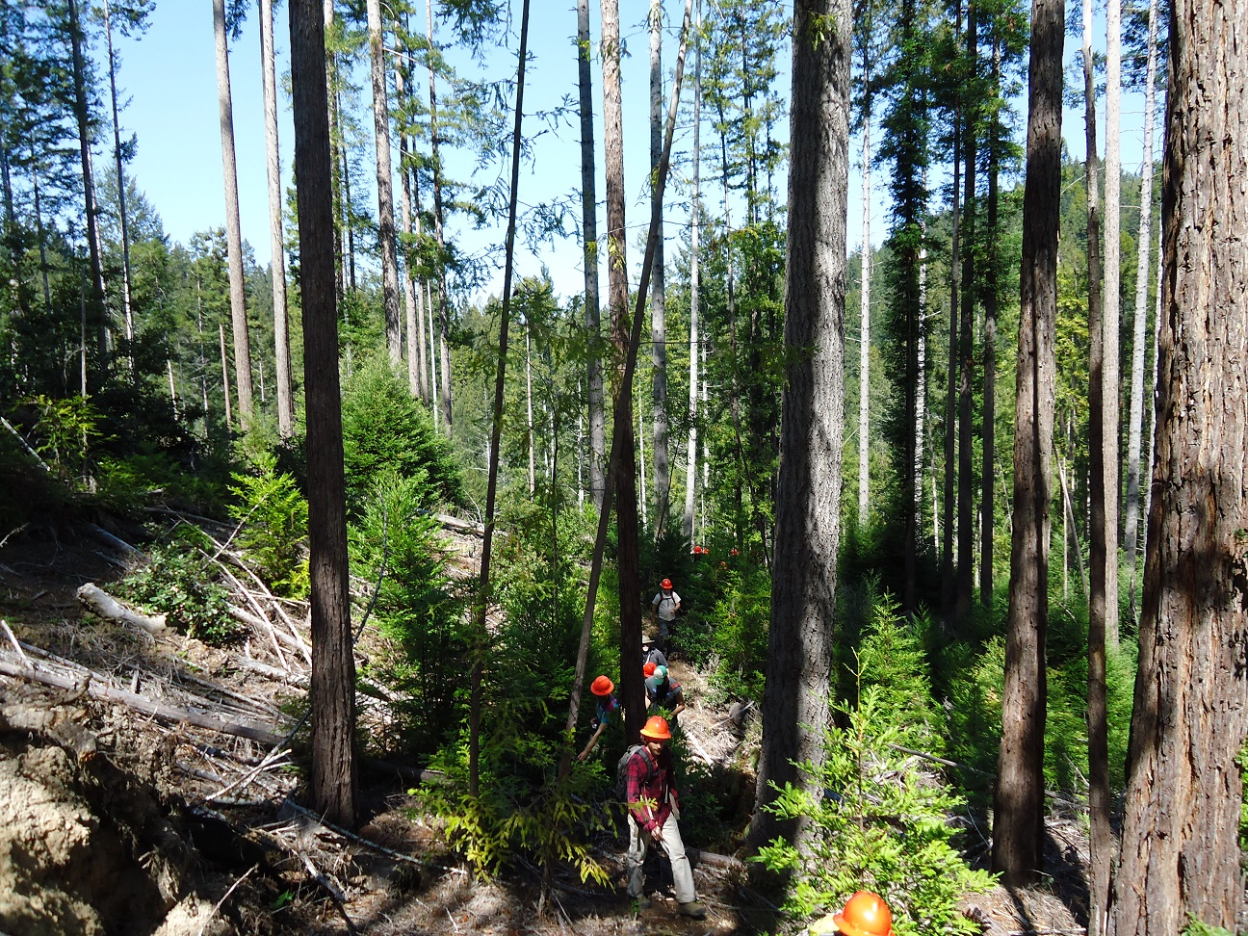
2015

Slide 26
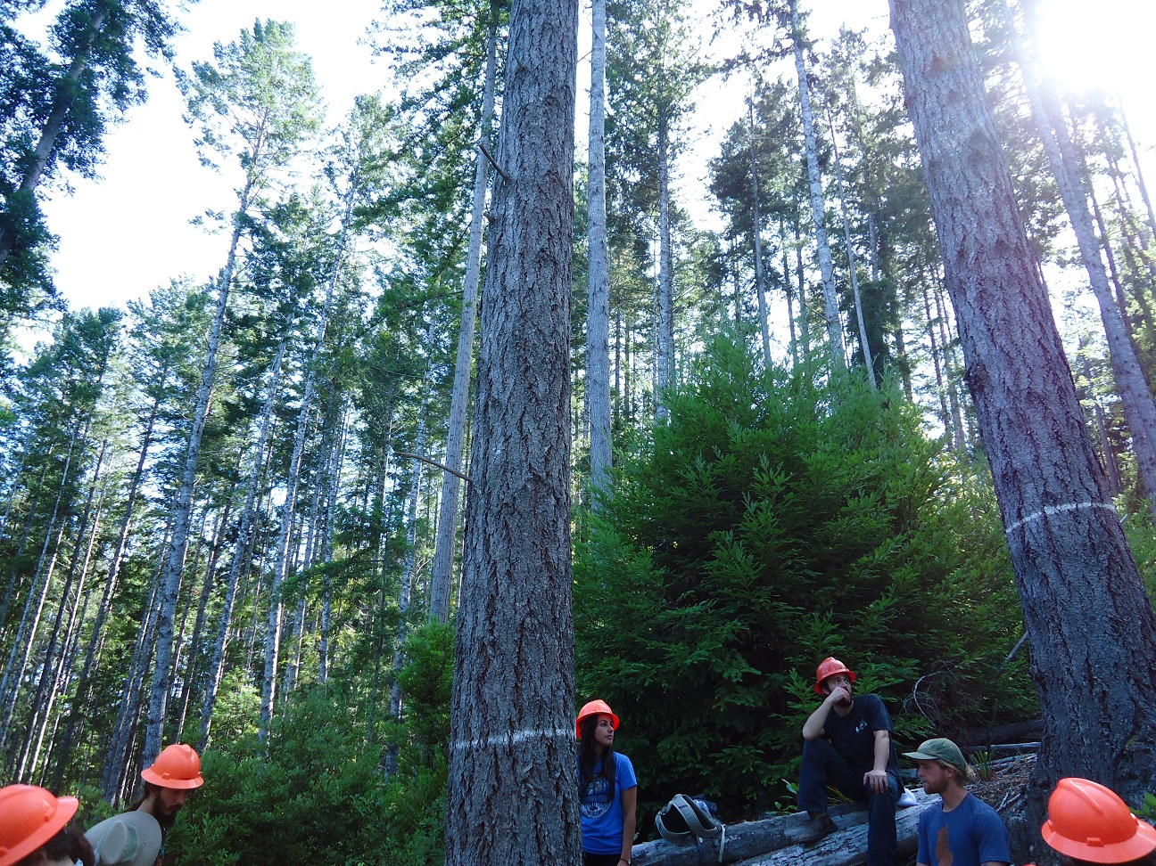
2016

Slide 27
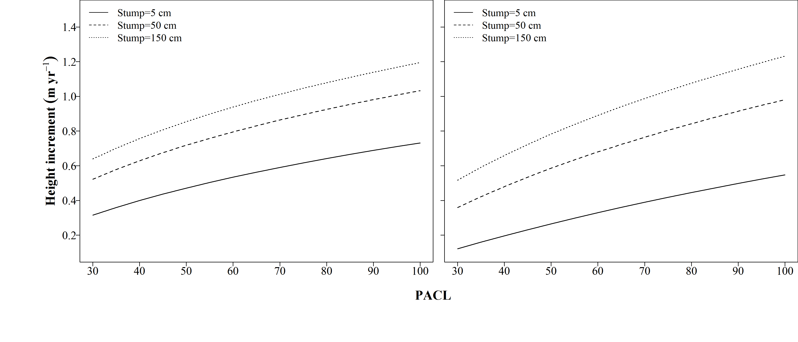
Greater height growth of redwood stump sprouts with more light (PACL), on larger stumps
Year 2 Year 3
Growth more sensitive to understory light in year 3 than in year 2
Notes:
For the PACL models, it was found that at 3 levels of stump diameter (5 cm, 150 cm, 150 cm), height increment increased at a decreasing rate as PACL increased. When comparing year 2 to year 3, it can be seen that there is more separation between the curves at 5cm, 50cm and 150 cm, especially when the stump diameter is held at 5cm. This indicates that stump diameter height increment is more limited at lower stump sizes than higher stump sizes, and larger stump sizes do not limit growth as much. But it can be observed that these limitations increase from year 2 to year 3 (Figure 13 A&B).

Slide 28
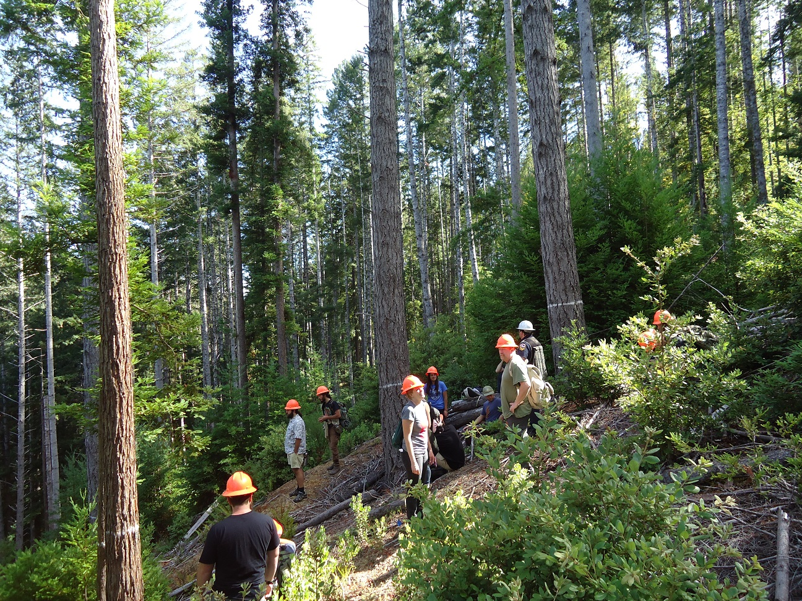
Comparison of redwood vs tanoak sprouts
2016

Slide 29
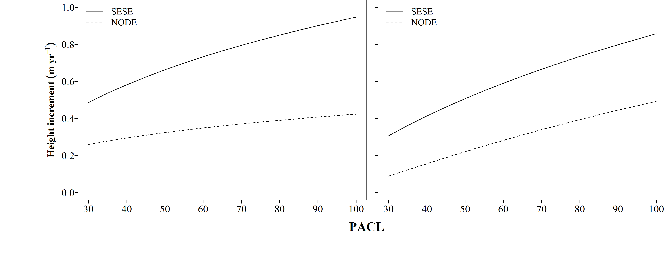
Redwood sprouts outperform tanoak sprouts at all light levels
Year 2 Year 3
Tanoak growth much more sensitive to understory light in year 3 than in year 2

Slide 30
Redwood sprouts outperform tanoak sprouts at all light levels
Greatest difference between redwood sprouts and tanoak sprouts
Fastest growth of redwood sprouts and tanoak sprouts

Slide 31

Acknowledgements
Brian Barrett &
Shawn Headley (CAL FIRE)
Humboldt State University students: Devin Eastman, Gabriel Goff, Ethan Hammett, Christopher Kirk, Forrest Kirk, Daniel Kluegel, Travis Munoz, Treelight Morgan-Menzies, Robert Muma, Brandon Namm, Karl Peterson, Aidan Stephens, Chris Valness and the
FOR 315 classes of spring 2013 and 2014, and
FOR 432 classes of fall 2010 and 2011.
Funding for this project was provided by the McIntire-Stennis Cooperative Research Program, the University of California (UC-CSU Collaborative Grant) and by the California Department of Forestry and Fire Protection (CAL FIRE).

Slide 32
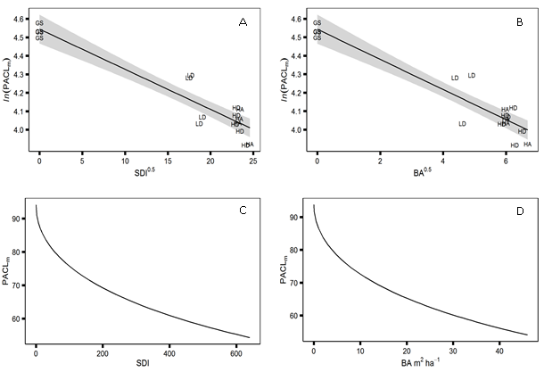
Average understory light (mean PACL) did not differ among aggregated (HA) vs dispersed (HD) treatments
Notes:
Step AIC and R2 determined the best models. SDI explained variance of PACL the best out of the three models, with the lowest AICc and highest R² of 0.889. The worst fit of the three models was the treatment model, which still had an R² of 0.843. A logarithmic transformation of mean PACL and square root transformation of both SDI and basal area revealed a negative relationship between density of plot and PACLm of treatment plot (mean PACL) (Figure 9).

Slide 33
Three treatments are 3-cohort single-tree selection regimes testing:
– Low v. high density (DMZ upper limits of 30% vs. 50% of redwood SDI upper limit)
– Residual trees retained in different spatial patterns (dispersed v. aggregated)
The 4th treatment is a group selection regime for comparison of open-grown regeneration (seedlings and sprouts) in full light against the partially-shaded regeneration in the other treatments

Slide 34
Understory light and SDI among treatments
Mean PACL, Mean SDI and range of PACL across all four sites
Treatment | n | Mean PACL (SE) | Min.-Max. PACL | Mean SDI (SE)
Group Selection (control) | 4 | 93.84(0.17) | 80.78-99.16 | 0
High Density Aggregated | 4 | 59.10(0.37) | 37.74-75.15 | 537.31(3.19)
High Density Dispersed | 5 | 58.35(0.30) | 33.76-74.33 | 543.00(0.92)
Low Density Dispersed | 4 | 68.59(0.62) | 38.83-85.39 | 325.54(1.17)

Slide 35
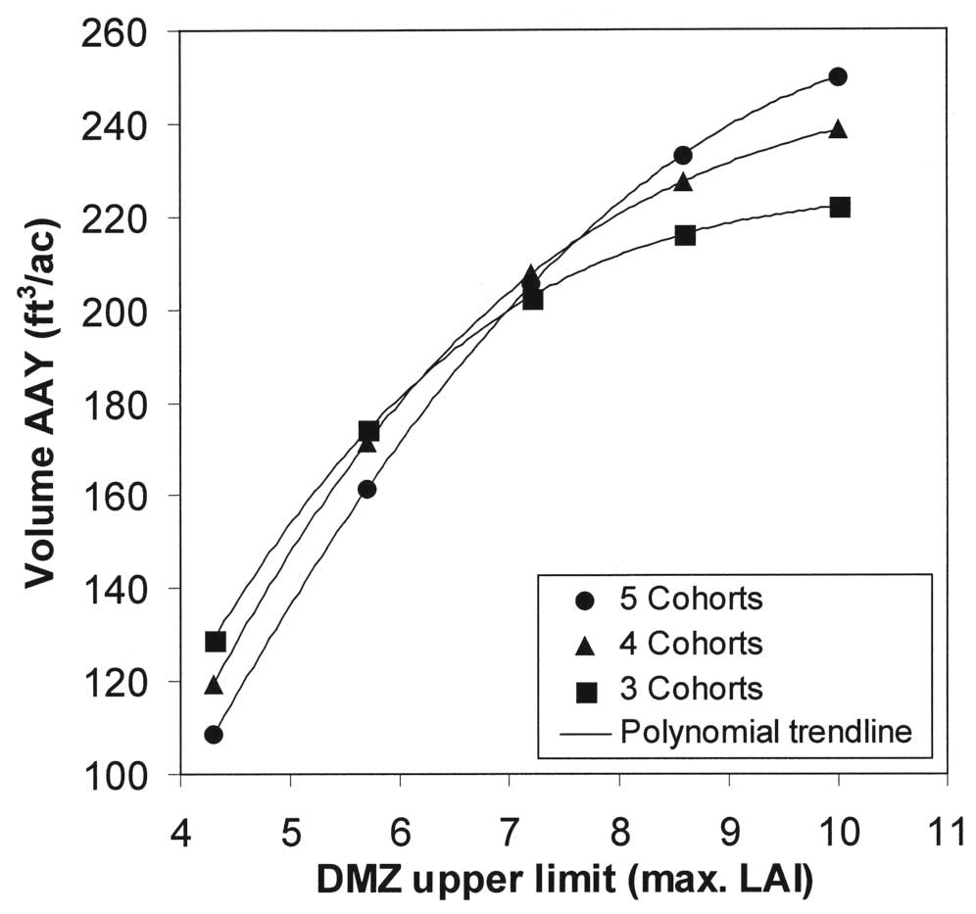
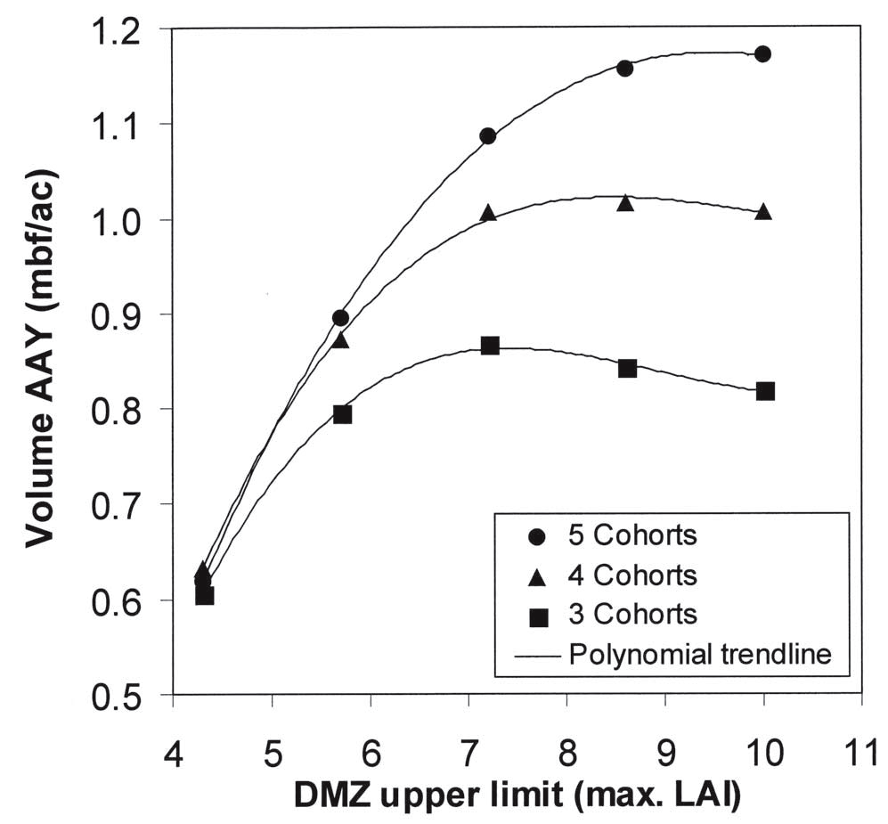
DMZ upper limit - “cut when stocking reaches…”
30% 40% 50% 60% 70% of max. 30% 40% 50% 60% 70% max.
Board foot volume yield ‘plateau’ at high stockings, due to smaller tree sizes
Figure: Effect of DMZ on stand volume production in multiaged stands with 3-5 cohorts managed on a 20-year cutting cycle. Berrill & O’Hara 2009 WJAF

